Slide 1
My Country Albania,
a breathtaking place, a paradise on Earth .

Slide 2
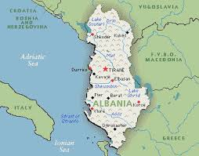
Albanians (as one of innumerous Illyrian tribes) were named after their city state Albanopolis near a mountain called Alp ‘mountain’, Hittite alpa ‘white’ The name Albania is derived from the name of an Illyrian tribe called the Arbër, or Arbëresh, and later Albanoi, that lived near Durrës. The kingdom of Illyria grew from the general area of modern-day Albania and eventually controlled much of the eastern Adriatic coastline.

Slide 3
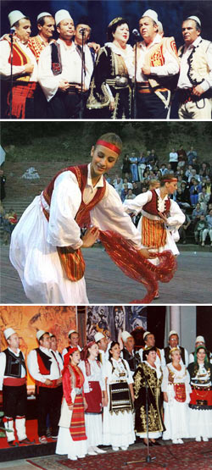
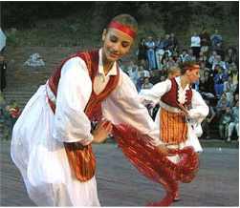
FOLK COSTUME AND ISO- POLYPHONY

Slide 4
“Iso-Polyphony – National Festival“, Vlora National Typological Festival of Iso-Polyphony is a powerful promoter of one of the most original strands in Albanian folk music iso-polyphony. The festival not only helps promote iso-polyphony in areas beyond its immediate reach, but it also helps the regions where iso-polyphony is a tradition to maintain and further develop this wonderful type of singing. 25 November 2005, UNESCO declared Albanian Iso-Polyphony “Masterpiece of the Oral Inheritance of Human Kind”.

Slide 5
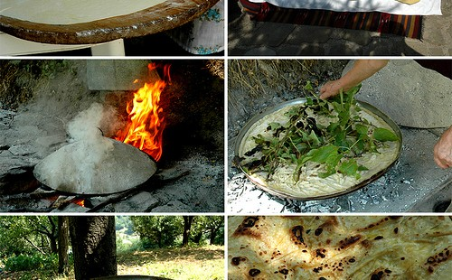
Culinary - Albania cuisine

Slide 6
We all know that the Albanian cuisine is a mix of Turkish, Balkan and European culinary influences, but it certainly retains its originality with the basic elements of a rich and characteristic cuisine, such as meat, fish, cheese and vegetables. Albania won first place in this festival for most special dishes, “bio” products and a high level of cooking, represented by a well-known restaurant in Tirana, “Sofra e Ariut’’

Slide 7
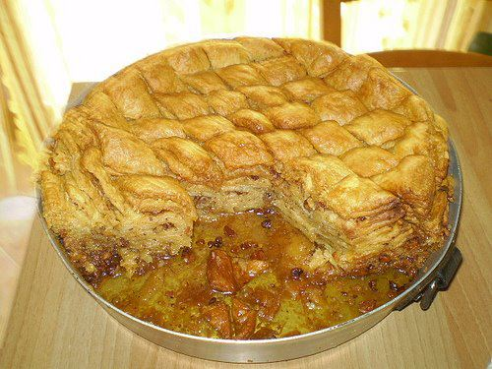
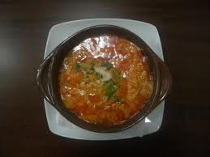

Slide 8
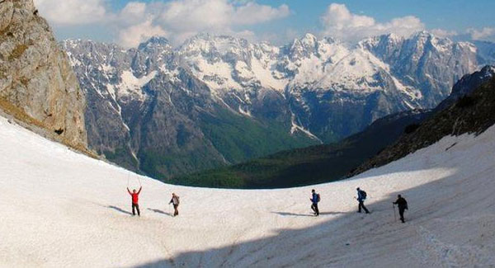
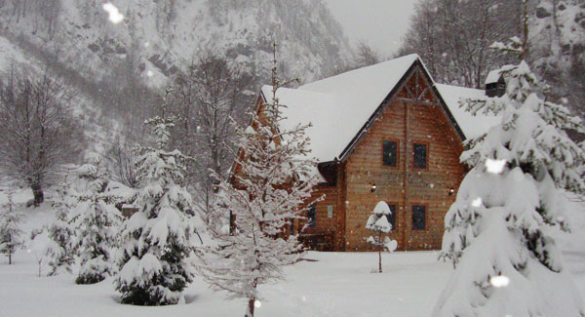
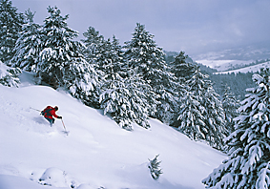

Slide 9
SKIING IN ALBANIA: VALBONA VALLEY
It’s that time of the year again, when ski enthusiasts look for the next best ski resort. Unfortunately, Albania doesn’t have ski resorts – it does, however, have excellent ski opportunities, and one of the best and most scenic of all is the beautiful Valbona Valley, in the Tropoja District of Northern Albania. Another option, as interesting, is the Quku i Valbonës (‘Valbona Hollow’) guesthouse – a unique experience as well, where guests are treated with delicious traditional meals cooked with fresh ingredients grown at the farm.

Slide 10
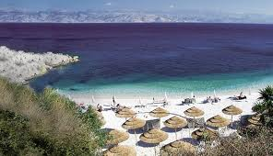
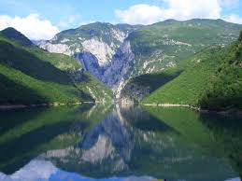
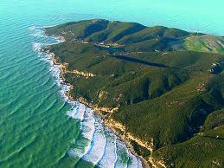

Slide 11
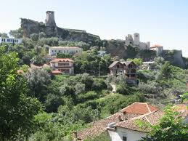
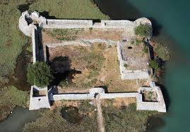
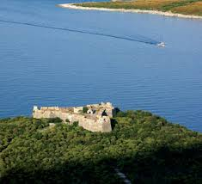
Castles of Albania

Slide 12
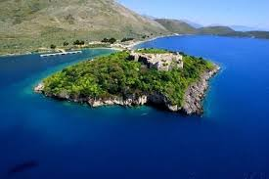
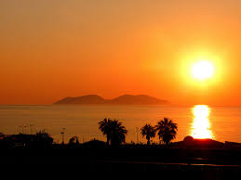
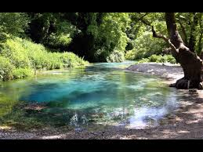
A place where the sun meets the sea …

Slide 13
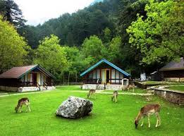
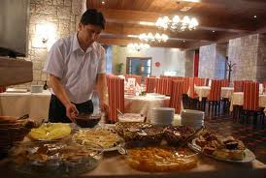
Llogara a relaxing place ,a cool breeze

Slide 14
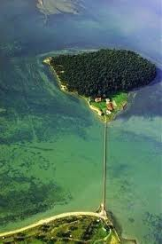
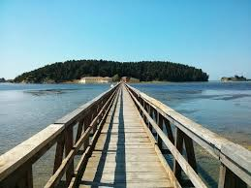
Zvernec- The sleeping Beauty of Vlora

Slide 15
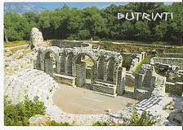
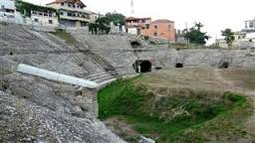
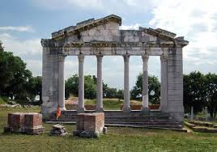
ANCIENT AMPHITHEATRES

Slide 16
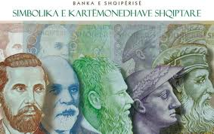
Its currency is lek.
Coins and banknotes

Slide 17
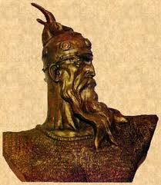
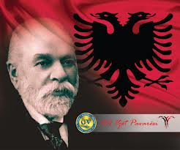
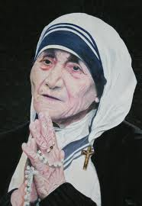
The most important persons in our history

Slide 18
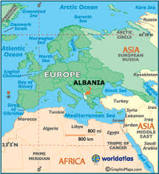
AN ANCIENT COUNTRY FULL OF HISTORY

Slide 19
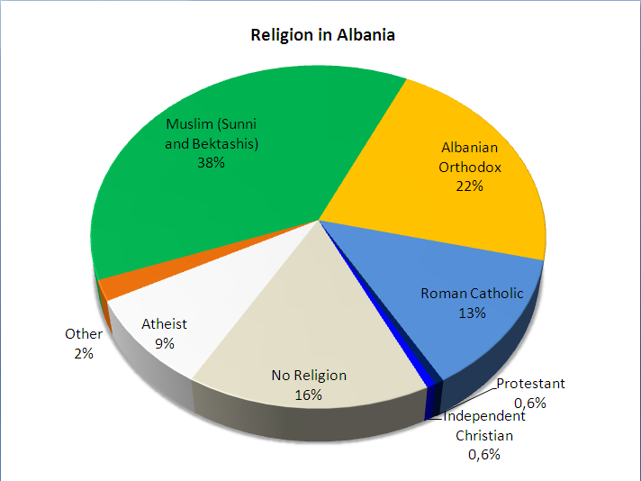
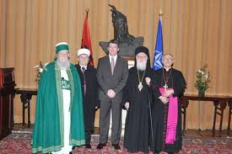
RELIGIOUS HARMONY

